Slide 1
Census Solutions Workshops
Claire Ross
National Partnership Program
U.S. Census Bureau

Slide 2
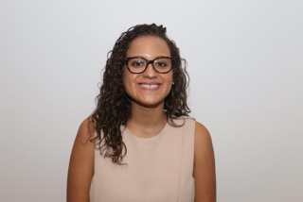
Claire Ross, Account Manager
National Partnership Program
Communications Directorate (ADCOM)

Slide 3
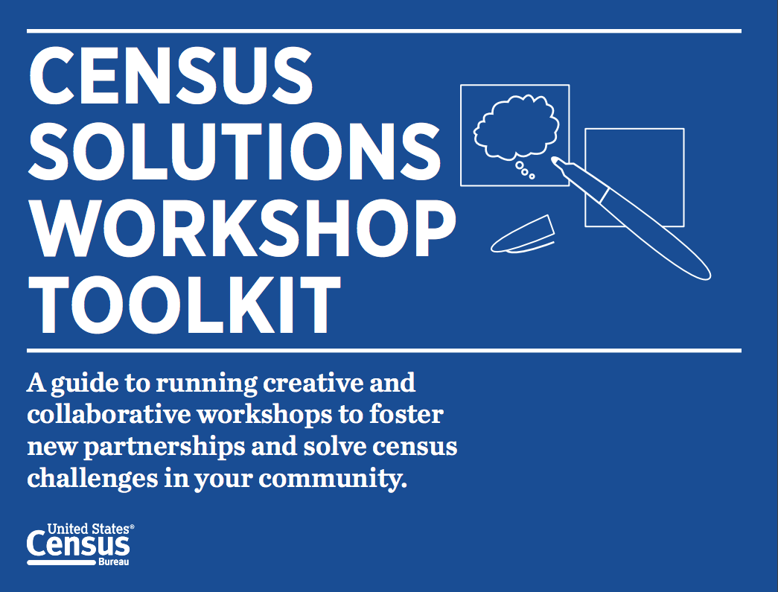
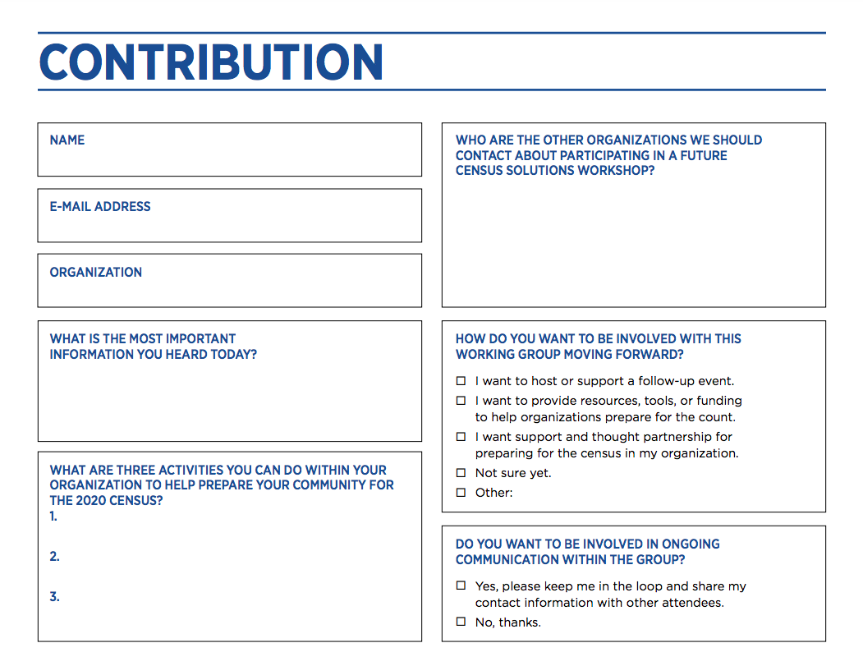
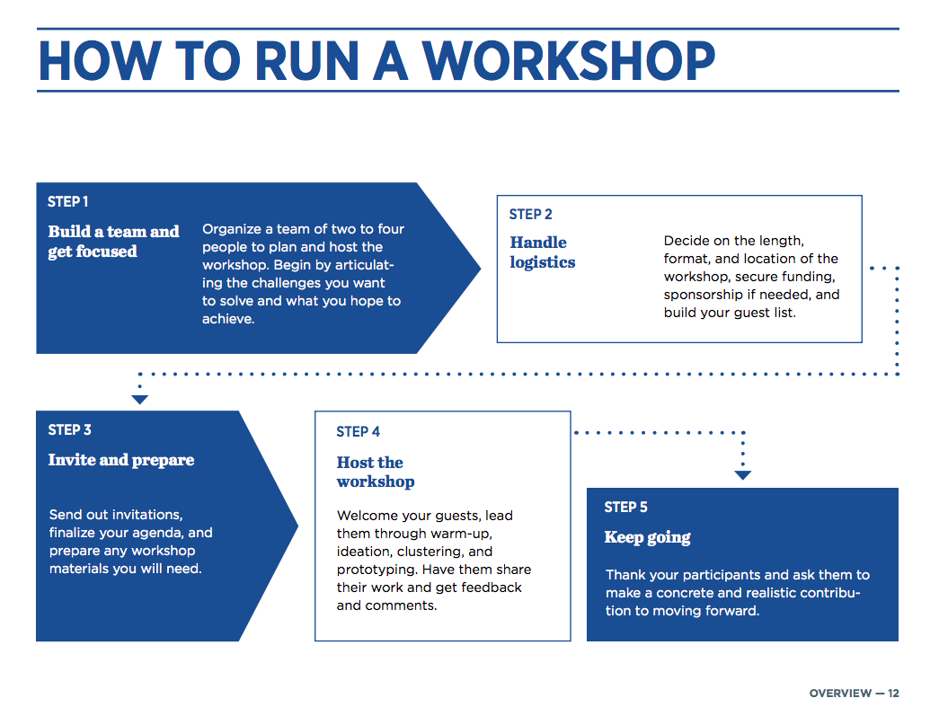
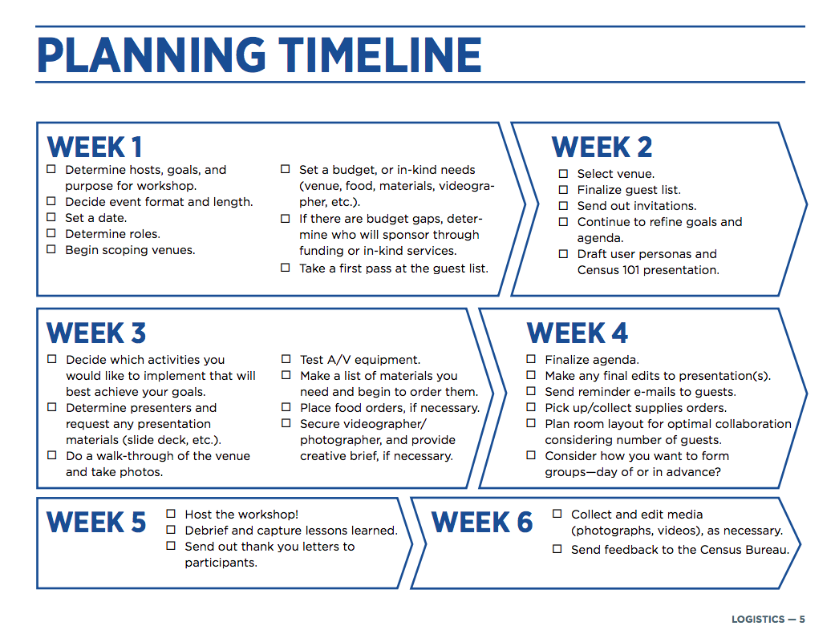
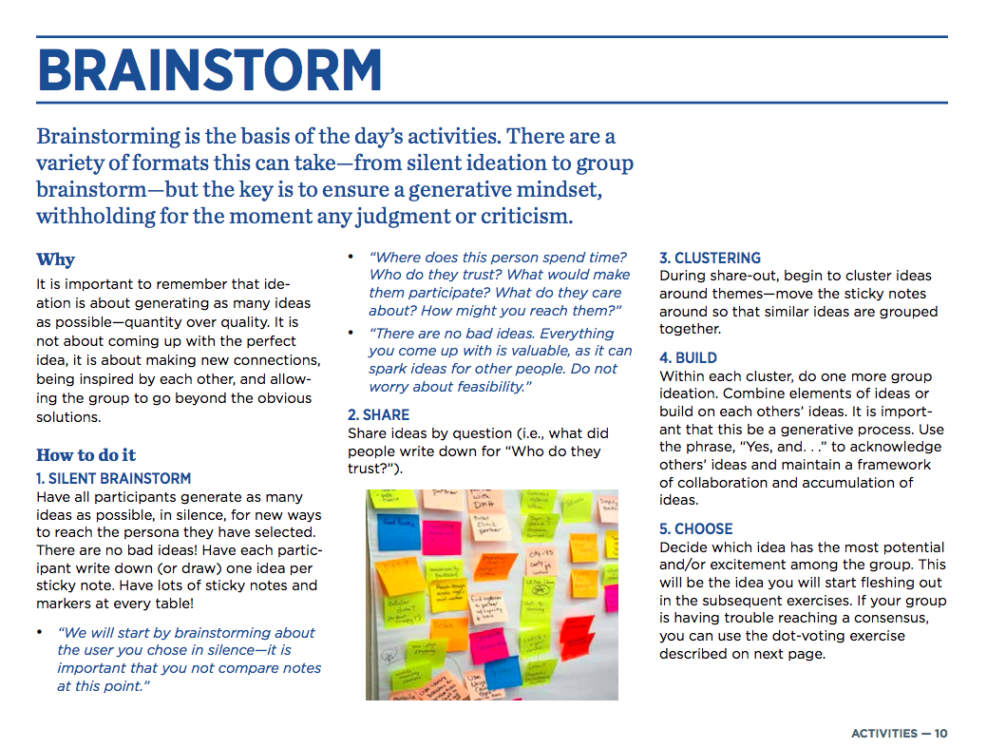
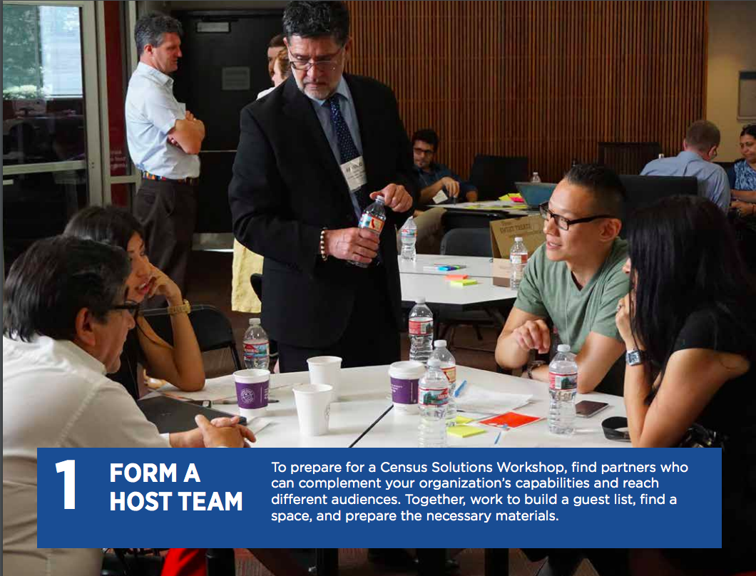

Slide 4
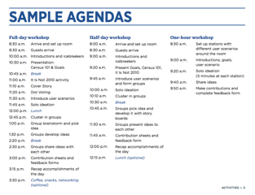
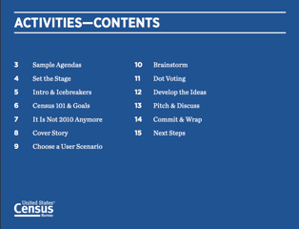

Slide 5
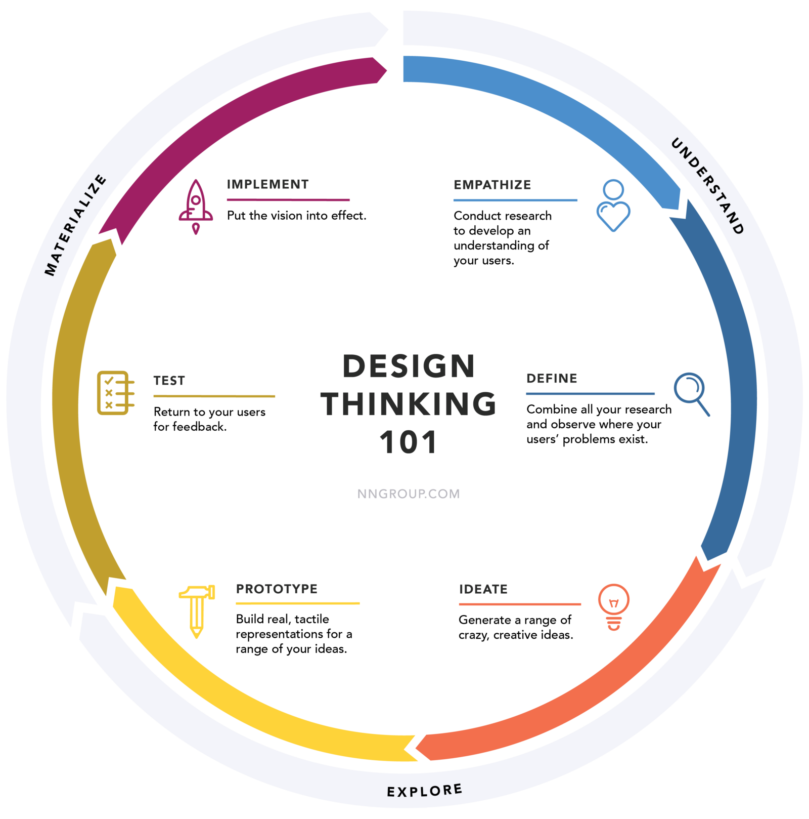
Design Thinking 101
Source: Nielsen Norman Group

Slide 6
Workshop Objectives
Build connections and seed collaborations between organizations and individuals committed to a successful 2020 Census
Develop actionable concepts that can lead to a stronger awareness & outreach campaigns to reach the communities you serve
Build momentum towards making ideas come to life by generating contributions and developing them through 2020
Showcase a model that other cities and towns can use to generate collaborative relationships with stakeholders and ideas to reach their own hard to count populations

Slide 7
Providence, Rhode Island
April 13, 2018
Partners included: National Urban League, Annie E. Casey Foundation, American Library Association, Rhode Island Kids Count, RI Office of Library and Information Services, and Children’s Leadership Council
Participants: 54
A few of the organizations represented:
Say Yes to Education
Scholastic
Brown University - State Data Center
The Joyce Foundation
Partnership for America's Children
RI Library Association
City of Providence
Brown University Population Studies and Training Center
Examples of commitments:
Put Census on the agenda for the National Kids Count Conference
Plan a race to raise awareness on the importance of the Census
Hold webinars for state and local advocates
Provide tablets or iPads to local barbershops to reach African American men (between the ages of 18-24) to complete the questionnaire
Notes:
45 non-census

Slide 8
Challenge Statements
How might we amplify collaborative partnerships and resources to ensure young children between the ages of 0-5 are accurately counted in the 2020 Census?
How might we improve the undercount of hard-to-count populations, particularly among young African American men (ages 16-24)?
How might we develop outreach strategies to address the digital divide (low internet connectivity areas) in communities of color and other hard-to-count communities?
How might libraries serve as community hubs for census education, awareness and participation, especially among hard-to-count communities?

Slide 9
THANK YOU

Slide 10
census.partners@census.gov
census.gov/partners
National Partnership Program
Anna Owens
anna.m.owens@census.gov
National Partnership Program
Claire Ross
Claire.e.ross@census.gov

